Slide 1

Stroke Risk Factors and Management
Dr Mark McGlinchey
Consultant Physiotherapist
Guy’s and St Thomas’ NHS Foundation Trust
18th March 2025

Slide 2
By the end of this lecture, students should be able to
describe the differences in the global burden of disease
understand the difference between primary, secondary, and tertiary prevention
explain the risk factors associated with cardiovascular conditions
discuss the management of risk factors
discuss the Making Every Contact Count (MECC) approach
explain how to support clients to make lifestyle change

Slide 3
Burden of Disease
Burden of disease refers to the impact disease has on mortality and morbidity
Burden of disease can be measured by a metric called Disability Adjusted Life Years (DALYs), which measures lost health because of premature death, disease or disability
Global Burden of Disease Study has been collecting data on disease burden since 1990 from over 156 countries and involving over 7000 researchers

Slide 4
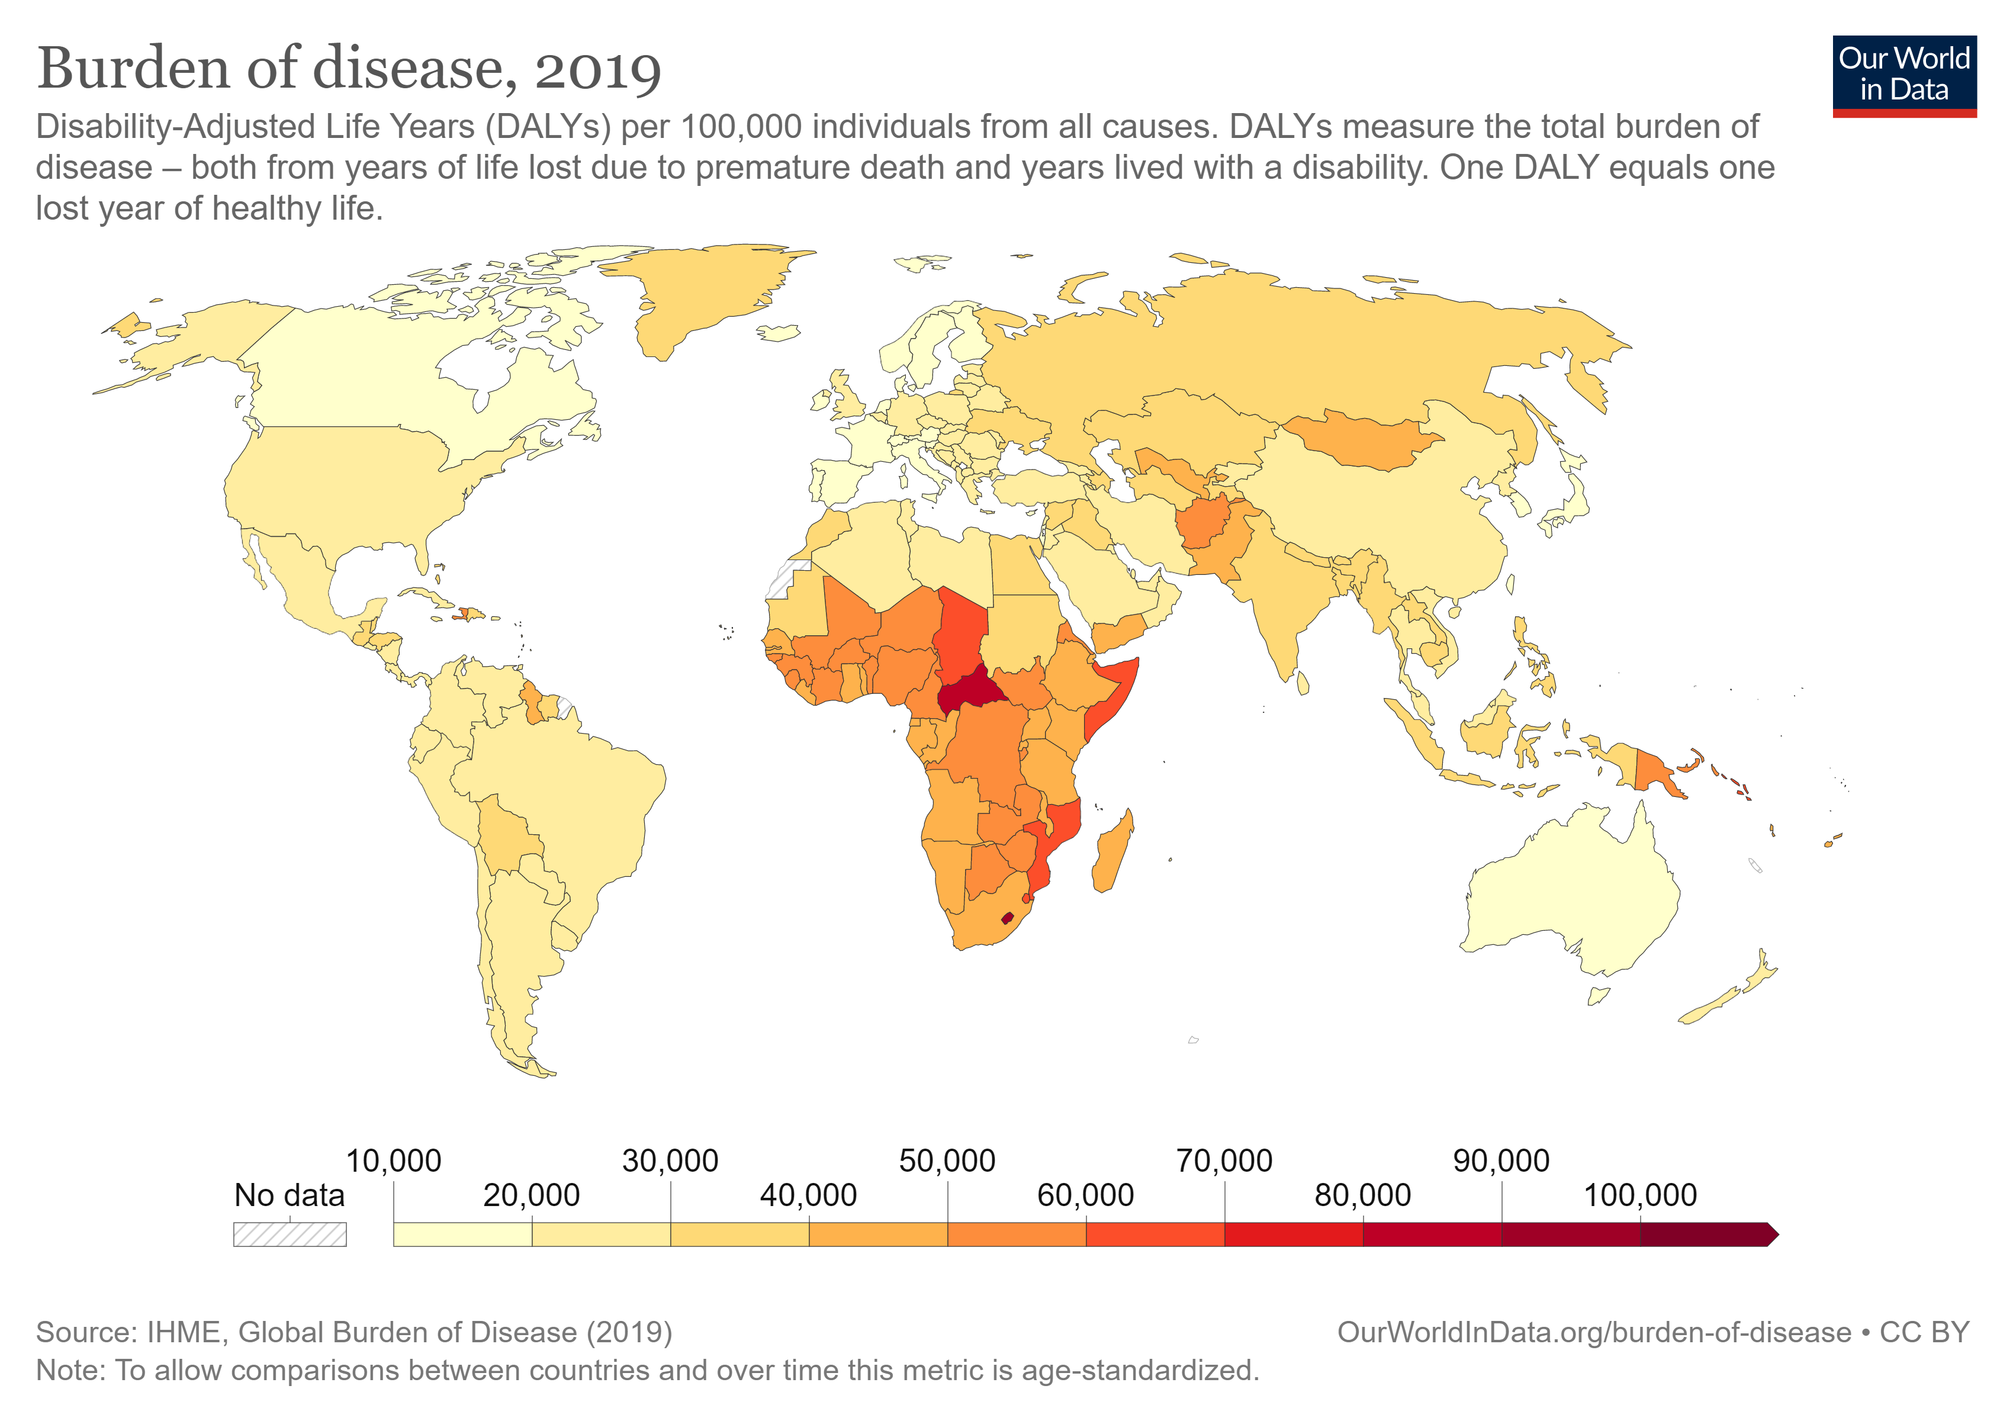

Slide 5
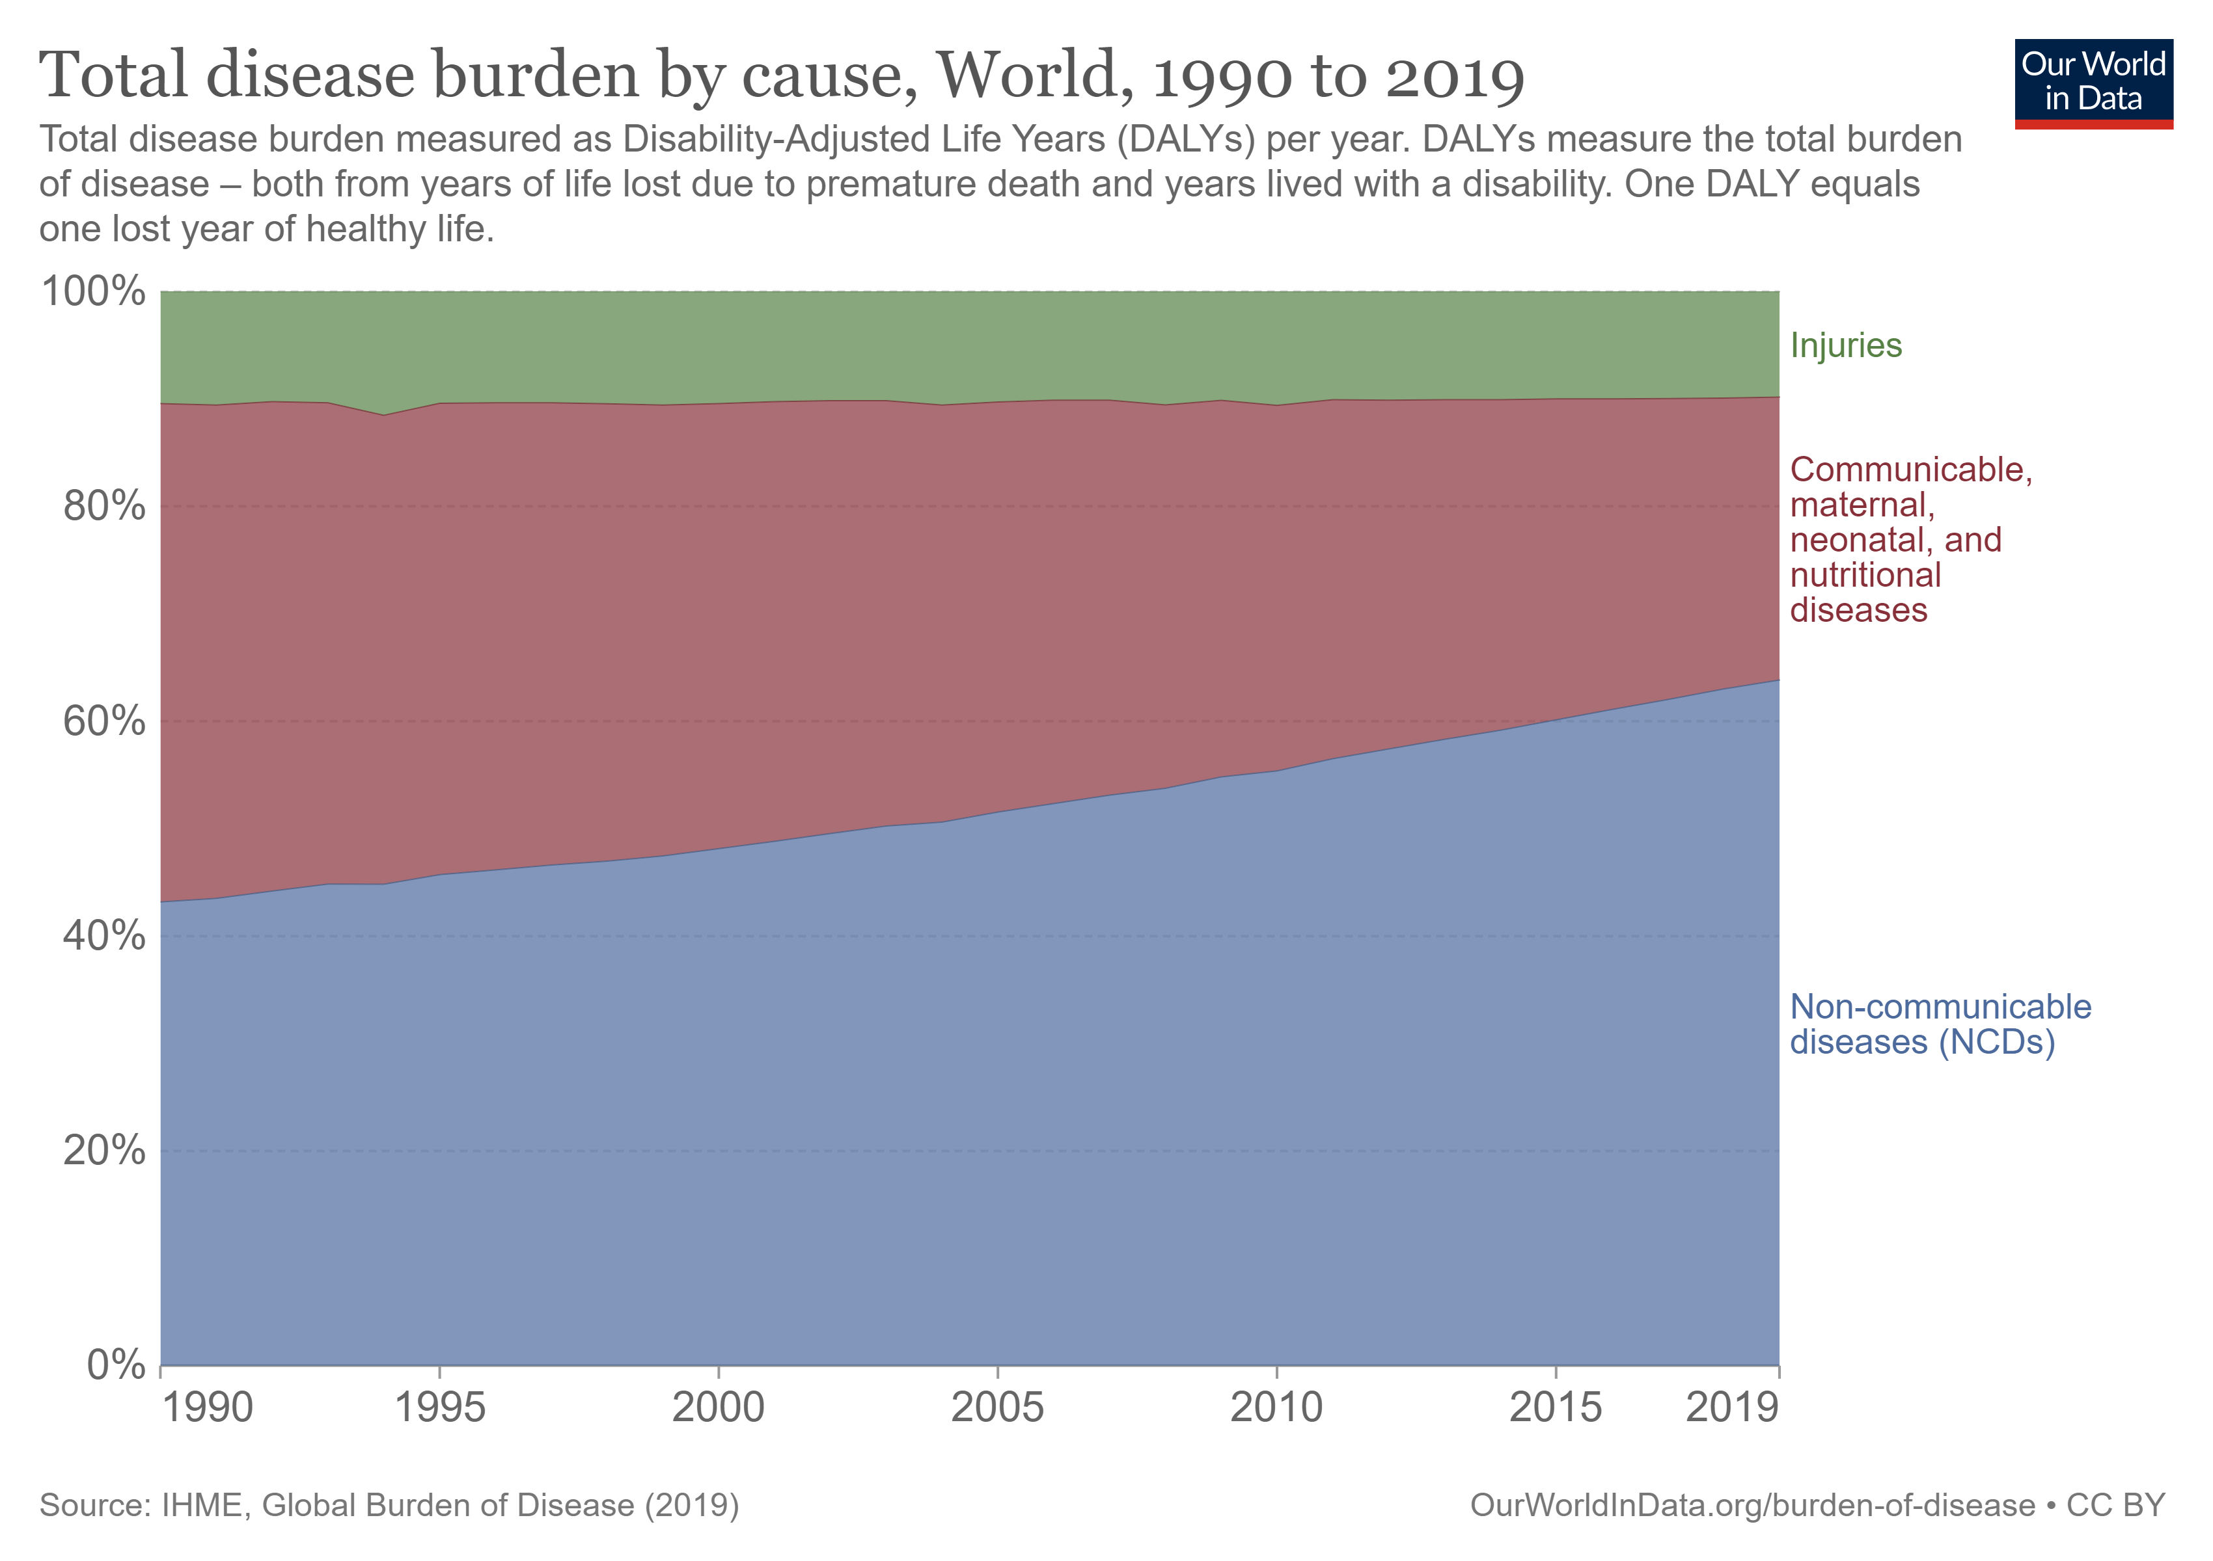
Global Differences in Disease Cause
In low-income nations, communicable disease still accounts for more than 60% across many countries
In high-income nations, NCDs typically account for more than 80% of disease burden whereas communicable diseases are low (<5%)

Slide 6
Global Burden of Disease
Over time, there has been a shift in burden towards NCDs due to reductions in communicable disease, improvements in overall health, living standards and incomes, as well as an ageing population
At a global level the most common causes of disease burden are:
cardiovascular diseases (15%)
cancer (9%)
neonatal disorders (7%)
musculoskeletal disorders (6%)
substance use disorders (5%)

Slide 7

Levels of Disease Prevention
Primary
Secondary
Tertiary

Slide 8
Primary Prevention
primary prevention aims to prevent disease before it occurs
this is achieved by preventing exposures to hazards that cause disease or altering unhealthy behaviours
Examples include
regular health check ups for hypertension, hypercholesterolaemia, and diabetes
medication to address known risk factors in high risk groups
education about healthy lifestyle

Slide 9
Secondary Prevention
secondary prevention aims to reduce the impact of a disease that has already occurred and prevent disease recurrence
this is achieved by detecting and treating disease as soon as possible to halt or slow its progress and strategies to prevent disease recurrence
Examples include
antiplatelet medication after ischaemic stroke
lifestyle modification, such as healthy diet and smoking cessation
six monthly post-stroke and annual stroke reviews

Slide 10
Tertiary Prevention
tertiary prevention aims to reduce the impact of an ongoing illness or injury that has lasting effects
this is achieved by helping people manage long-term illnesses to improve their function, quality of life and life expectancy
Examples include:
stroke rehabilitation delivered across the stroke pathway
support groups to share strategies for living well

Slide 11
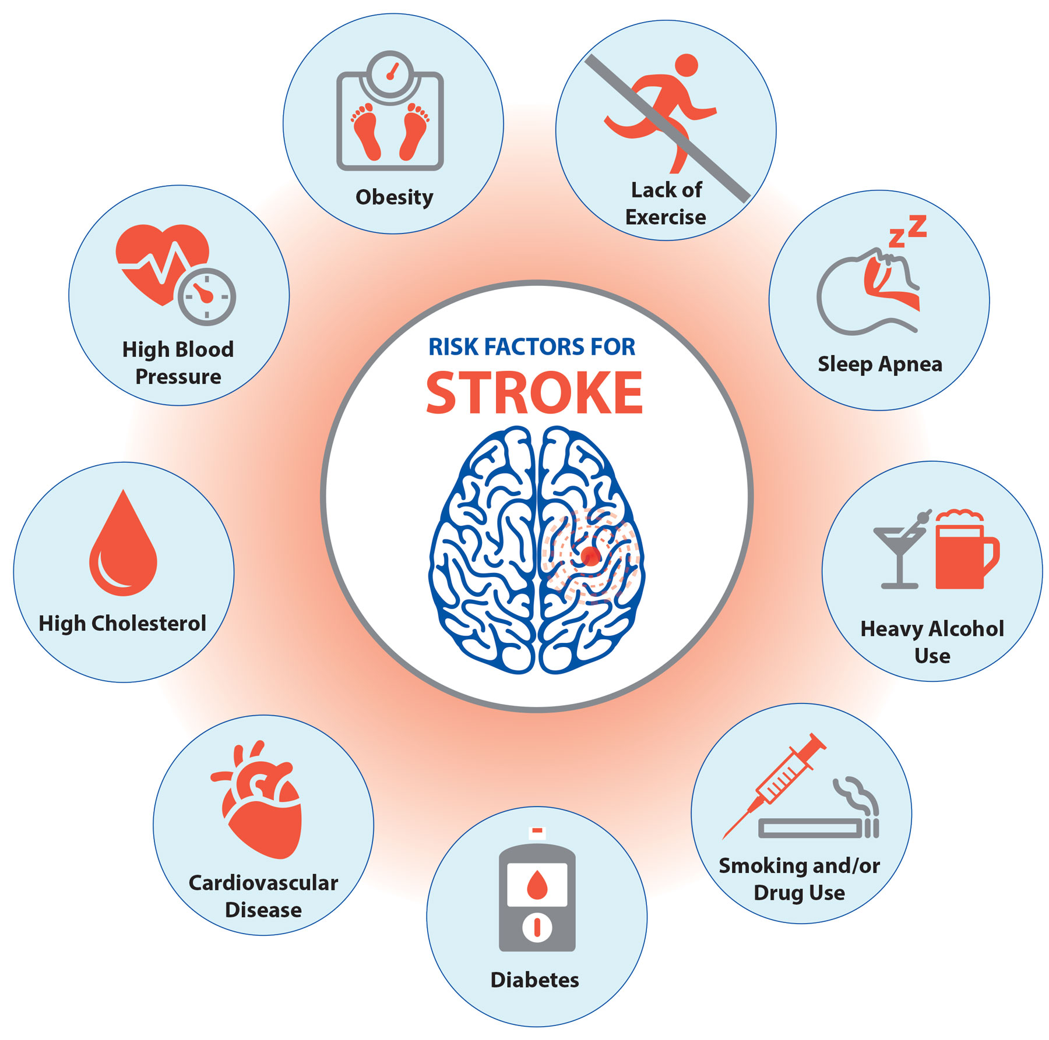
Risk Factors For Cardiovascular Disease
Modifiable factors
Medical
Lifestyle
Non-modifiable factors

Slide 12
Modifiable Medical Risk Factors
Hypertension
Atrial fibrillation
Hypercholesterolaemia
Diabetes mellitus
Notes:
hypertension (> 140/90 mmHg)
hypercholesterolaemia (total >5 mmol/L, LDL >4 mmol/L)
diabetes (blood glucose >7mmol/L before eating)

Slide 13
Modifiable Lifestyle Risk
Factors
Physical inactivity
Poor diet/obesity
Smoking
Alcohol consumption

Slide 14
Non-Modifiable Risk
Factors
Age
Sex
Race
Family history
Congenital factors
Previous stroke or TIA
Notes:
Age: most powerful independent risk factor
Gender: females more likely to have a stroke due to increased life expectancy and increased stroke risk with increasing age, males more likely < 55 years
Race: increased stroke in Black African/Caribbean populations, similarly Chinese and Japanese populations have increased risk of haemorrhagic stroke
Family history: increased risk if a first-degree relative has had coronary heart disease or stroke before the age of 55 years (for a male relative) or 65 years (for a female relative)
Previous stroke: the risk of recurrent stroke is greatest after first stroke; 2–3% of survivors of a first stroke have another stroke within the first 30 days, 9% in the first 6 months and 10–16% within a year; after the first year, the average annual risk of recurrent stroke for the next 4 years falls to about 5%

Slide 15
Risk Factor Management- Hypertension
28% relative risk reduction of recurrent stroke with antihypertensive drug use
optimal target BP for patients with established cardiovascular disease is <135/85mmHg
Benefits
33-46% reduction in fatal or disabling stroke
50-76% reduction in the risk of cerebral haemorrhage
38-42% reduction in non-fatal myocardial infarction

Slide 16
Risk Factor Management- Blood Thinning
antiplatelet agent (e.g. clopidogrel) for long-term vascular prevention in people with ischaemic stroke or TIA without paroxysmal or permanent atrial fibrillation
anticoagulation for people with ischaemic stroke or TIA and paroxysmal, persistent or permanent atrial fibrillation or atrial flutter

Slide 17

Risk Factor Management- Smoking
Smokers have 2 – 4 times the risk of stroke compared to non-smokers
Risk of stroke is similar to non-smoker 5 years after stopping smoking

Slide 18
Risk Factor Management- Lipid Control
people with ischaemic stroke or TIA should be treated with a statin drug unless contraindicated to ensure:
total cholesterol <4.0 mmol/L
LDL-cholesterol <1.8 mmol/L
people with intracerebral haemorrhage should be assessed for lipid-lowering therapy on the basis of their overall cardiovascular risk and the underlying cause of the haemorrhage

Slide 19
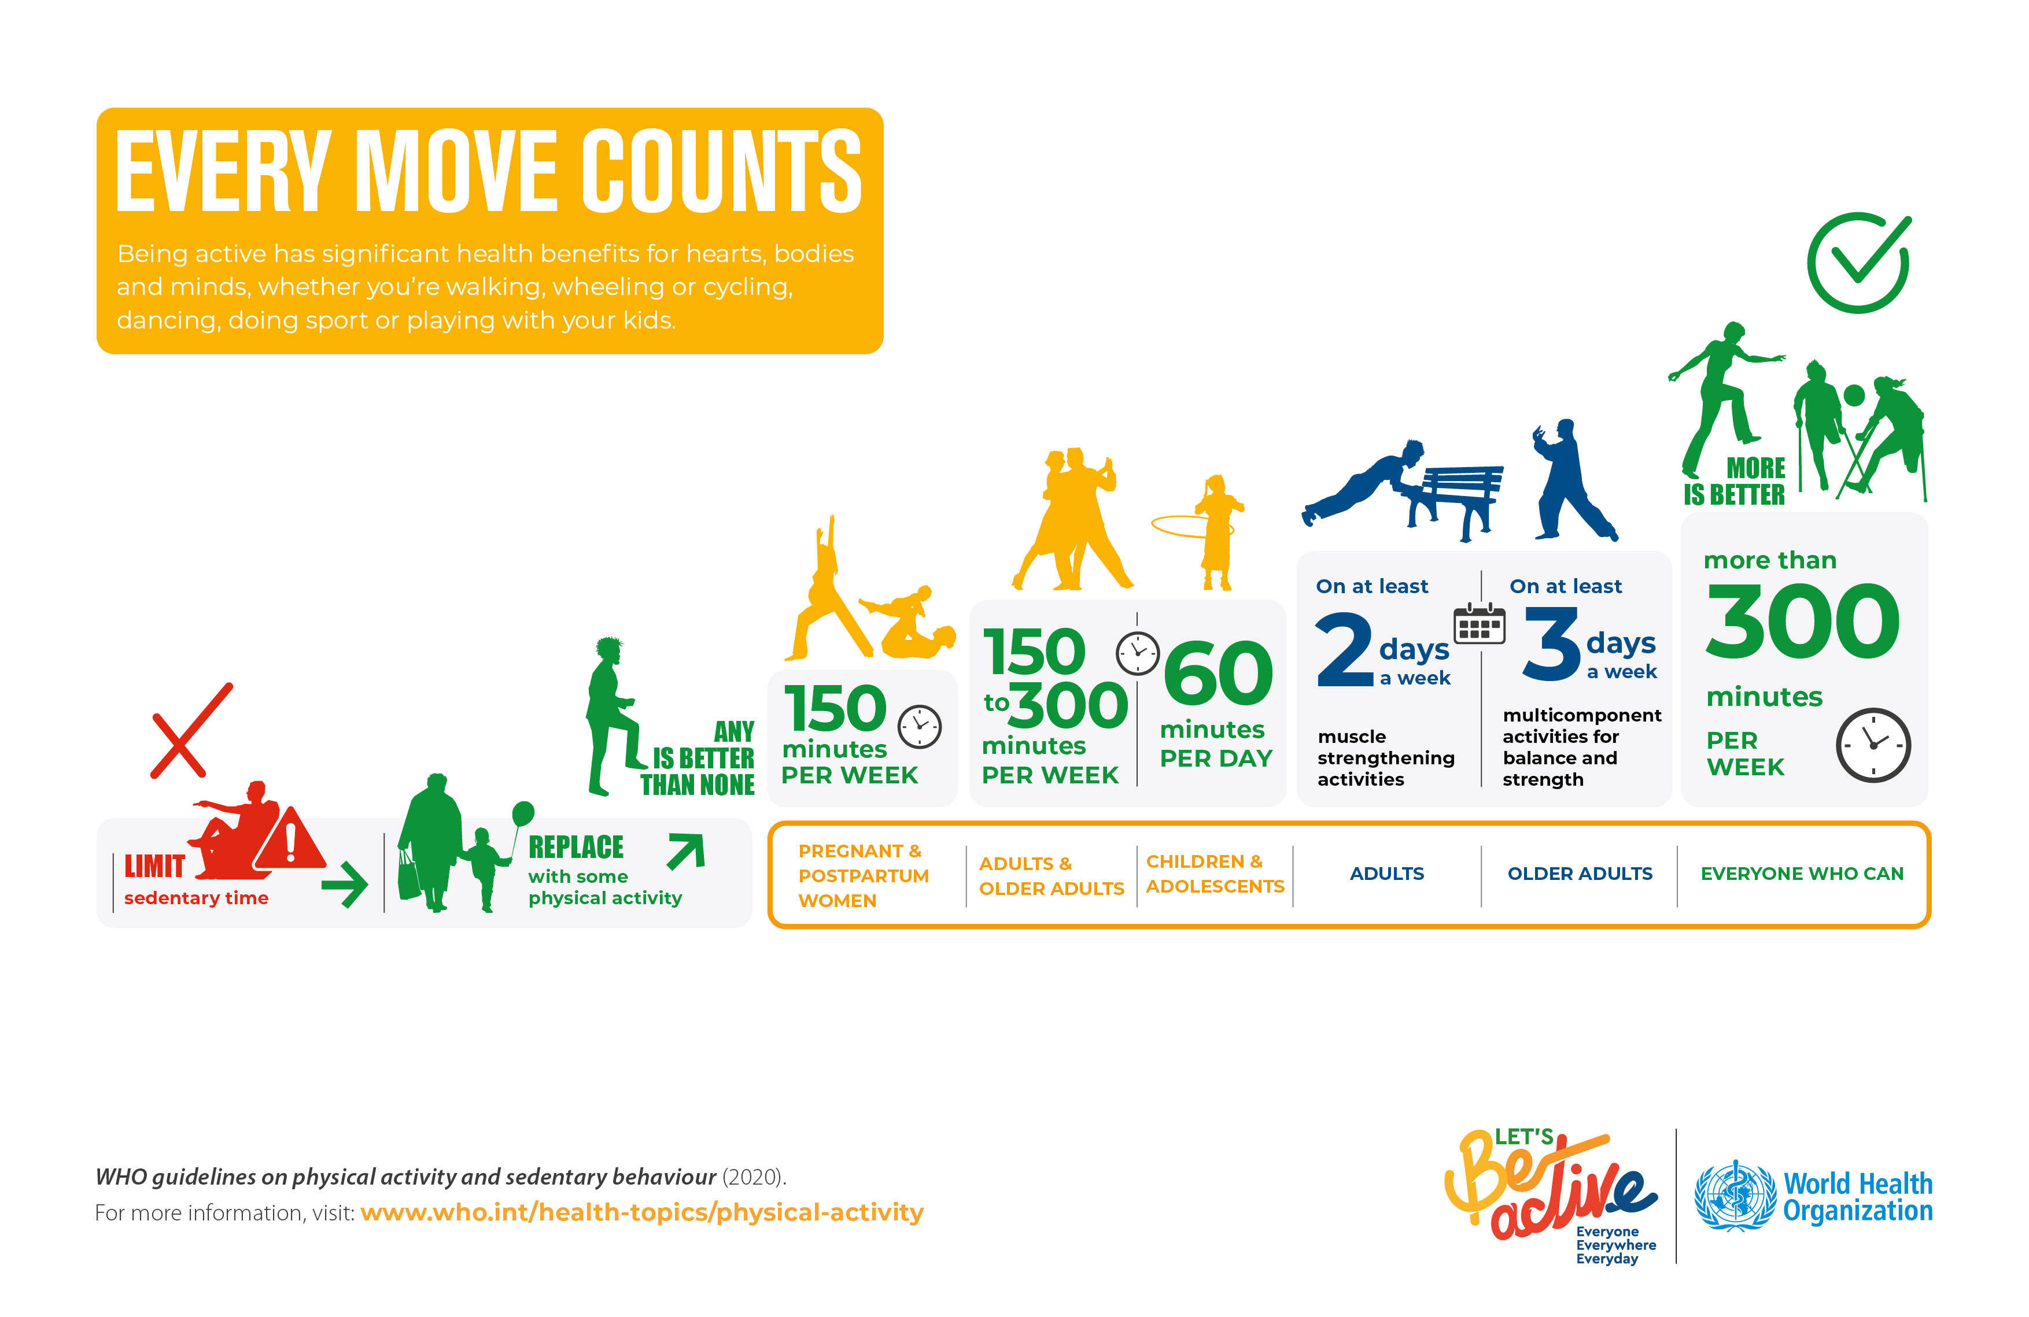
Risk Factor Management- Physical Activity

Slide 20
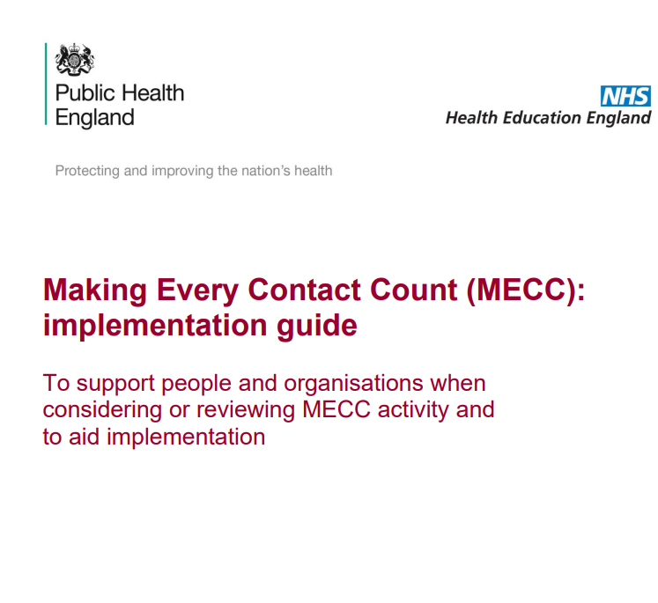
Making Every Contact Count
The Making Every Contact Count (MECC) approach encourages health and social care staff to use the opportunities arising during their routine interactions with patients to have conversations about how they might make positive improvements to their health or wellbeing

Slide 21
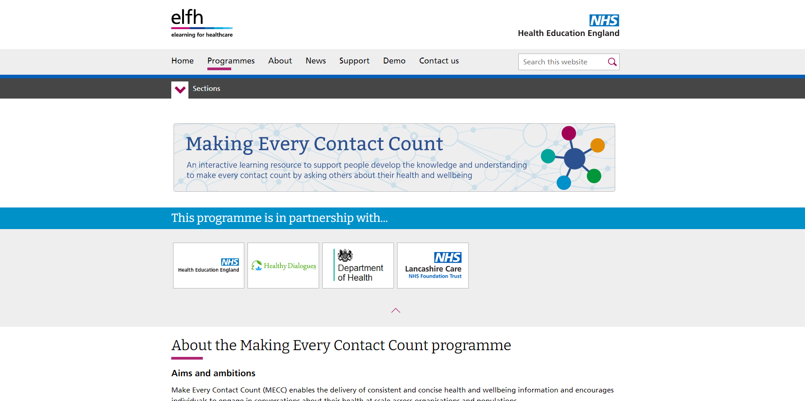

Slide 22
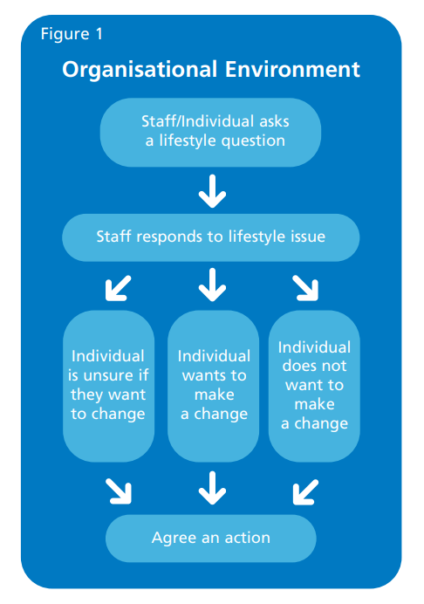
Making Every Moment Count

Slide 23
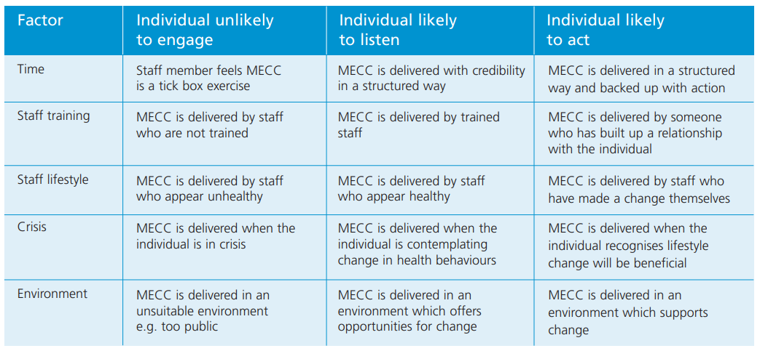

Slide 24
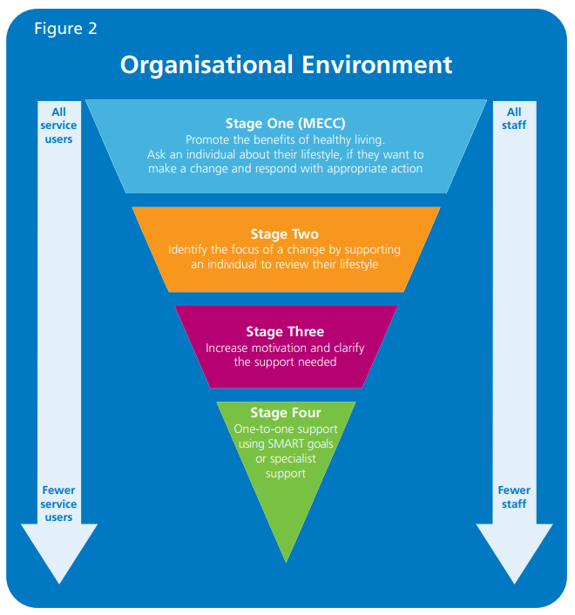
Behavioural Change Pathway

Slide 25
References
[1] Gueyffier F et al. (1997). Effect of antihypertensive treatment in patients having already suffered from stroke. Gathering the evidence. The INDANA (INdividual Data ANalysis of Antihypertensive intervention trials) Project Collaborators. Stroke. 28(12):2557-2562
[2] Institute for Work and Health 2015. At Work. Issue 80 / Spring 2015 / ISSN # 1261-5148
[3] Intercollegiate Stroke Working Party (2016). National clinical guideline for stroke - 5th edition
[4]Johnston SC, Gress DR, Browner WS & Sidney S, 2000. Short-term prognosis after emergency department diagnosis of TIA. JAMA, 284, 2901-2906
[5] Mohan KM et al. (2011). Risk and cumulative risk of stroke recurrence: a systematic review and meta-analysis. Stroke, 42, 1489-1494
[6] Roser M et al. (2021). Burden of disease. Published online at OurWorldInData.org. Retrieved from: 'https://ourworldindata.org/burden-of-disease' [Online Resource]
[7] NHS England- Midlands 2014. An Implementation Guide and Toolkit for Making Every Contact Count

